Slide 1
Periodicity with Sparse Fourier Transform
Adam Belhouchat and Joey Miller

Slide 2
Complexity
O(n)
Most expensive operation is finding peaks, mean, and standard deviation O(n)
Utilizes the sparse fourier transform assuming k=50. O(klog(N/k)log(N))

Slide 3
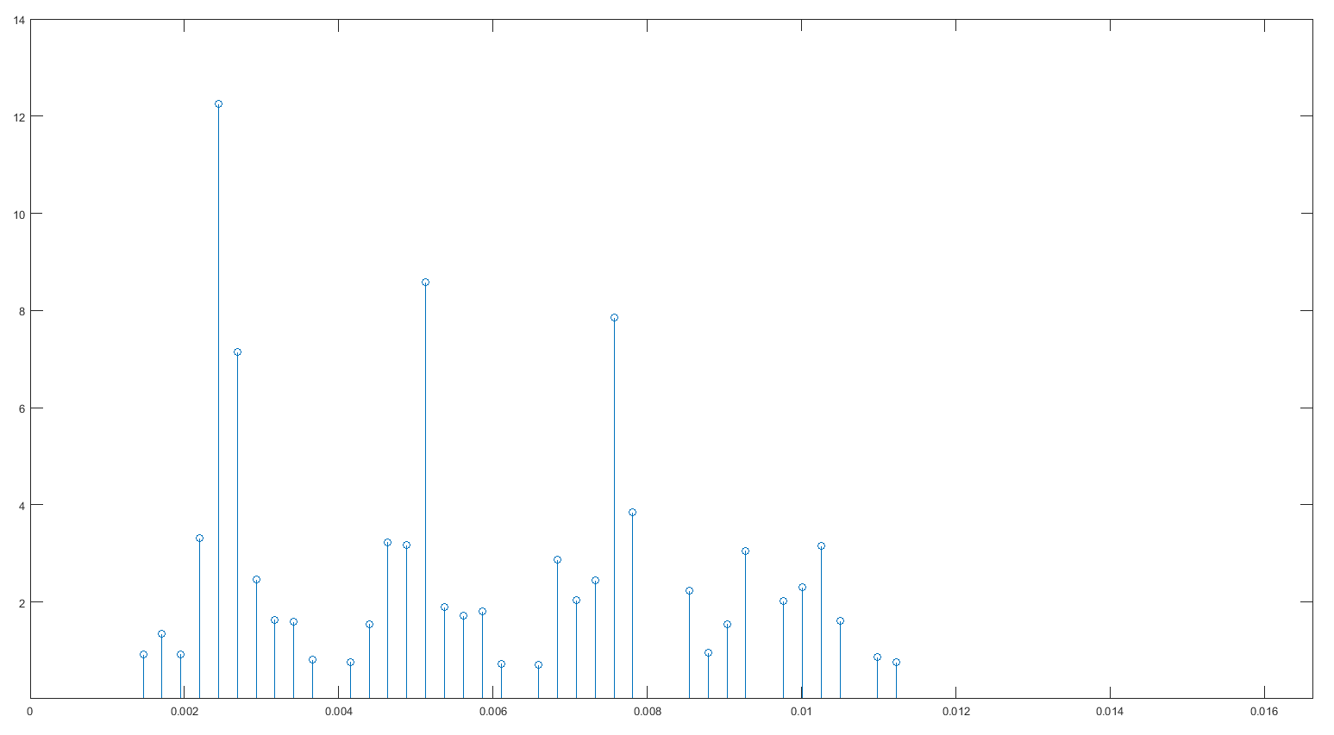
Algorithm
Finds sFFT of signal and keeps only first half (second half is redundant)
Find all peaks at least 9 std. dev. from the mean of dataset
Generate frequency axis from length of signal
Find frequency of first peak, set period equal to 1/frequency (rounded).

Slide 4
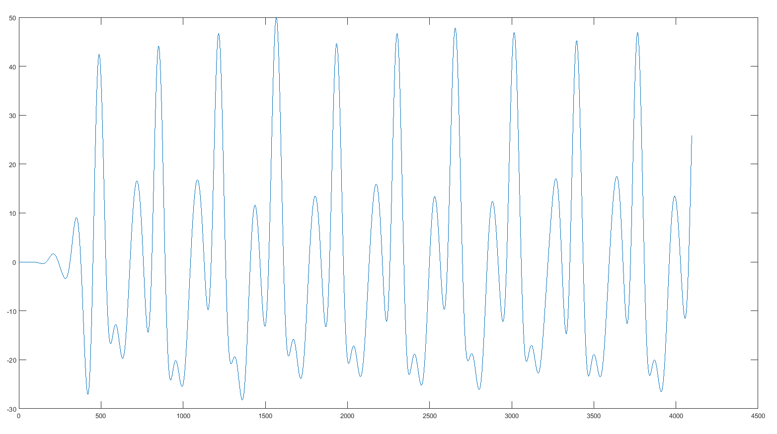
Reasoning
sFFT saves complexity, makes algorithm run in O(n) time.
Frequency axis gives exact values for frequencies comprising signal
Lower bound of 9 std. Dev. excludes peaks due to noise/incomplete period.
First peak chosen to account for appearance of higher frequencies in ECG data

